Slide 1

FINAL ASSESSMENT
TRIVIKRAMAN S
4400

Slide 2
Question 1
Average of Wait
28.01631702
The average lead time between the request date and completion date is approximately 28 days

Slide 3
Question 2
Row Labels | Count of Rush
Northwest | 45
Central | 17
Southeast | 13
North | 10
West | 5
East | 4
South | 4
Southwest | 3
Northeast | 2
Northwest has the highest number of rush jobs followed by Central and Southeast in 2nd and 3rd place

Slide 4
Question 3
Row Labels | Average of LbrHrs
No | 0.792267366 |  | 0.21
Yes | 0.586842105
Filled the blanks with Ctrl+G in Rush column to identify the non-rush jobs
Used the pivot table to find the average of Labor hours
There is average difference of 0.21 hours making the rush jobs consuming less hours on average

Slide 5
Question 4
This is the distribution of different payment types across different services
Payment | Service | Count of WO
Account | Assess | 178
 | Deliver | 100
 | Install | 24
 | Repair | 24
 | Replace | 115
Account Total |  | 441
C.O.D. | Assess | 148
 | Deliver | 60
 | Install | 25
 | Repair | 51
 | Replace | 97
C.O.D. Total |  | 381
Credit | Assess | 2
 | Repair | 1
 | Replace | 2
Credit Total |  | 5
P.O. | Assess | 66
 | Deliver | 20
 | Install | 9
 | Repair | 6
 | Replace | 31
P.O. Total |  | 132
Warranty | Assess | 13
 | Deliver | 10
 | Install | 5
 | Repair | 4
 | Replace | 9
Warranty Total |  | 41

Slide 6
Question 5
Over time customers have started opting for Credit based payment type and Warranty
There is a significant increase in number of orders in 2021 compared to 2020 with Payment type being Account and COD

Slide 7
Question 6
Using CORREL Function
=CORREL(H:H,L:L)
0.240201
There is 0.24(24%) positive correlation exist between number of technicians required and cost of parts

Slide 8
Question 7
Service | Central | East | North | Northeast | Northwest | South | Southeast | Southwest | West | (blank) | Grand Total
Assess | 46 | 19 | 64 | 18 | 70 | 63 | 67 | 7 | 53 |  | 407
Deliver | 26 | 9 | 49 | 4 | 28 | 33 | 21 | 2 | 18 |  | 190
Install | 16 | 2 | 7 | 4 | 7 | 17 | 4 | 1 | 5 |  | 63
Repair | 23 | 6 | 8 | 5 | 16 | 8 | 12 | 4 | 4 |  | 86
Replace | 47 | 17 | 35 | 6 | 50 | 29 | 31 | 7 | 32 |  | 254
Most common type of service is Assess across districts
Using Pivot table and finding the most claimed service from the dataset and after observing its distribution across the districts it is confirmed that Assess is the answer

Slide 9
Question 8
Row Labels | Count of WO
No | 959
Account | 441
C.O.D. | 381
Credit | 5
P.O. | 132
Yes | 41
Warranty | 41
All the work orders with Warranty has payment type Warranty
Those without warranty commonly done with Account and COD payment types

Slide 10
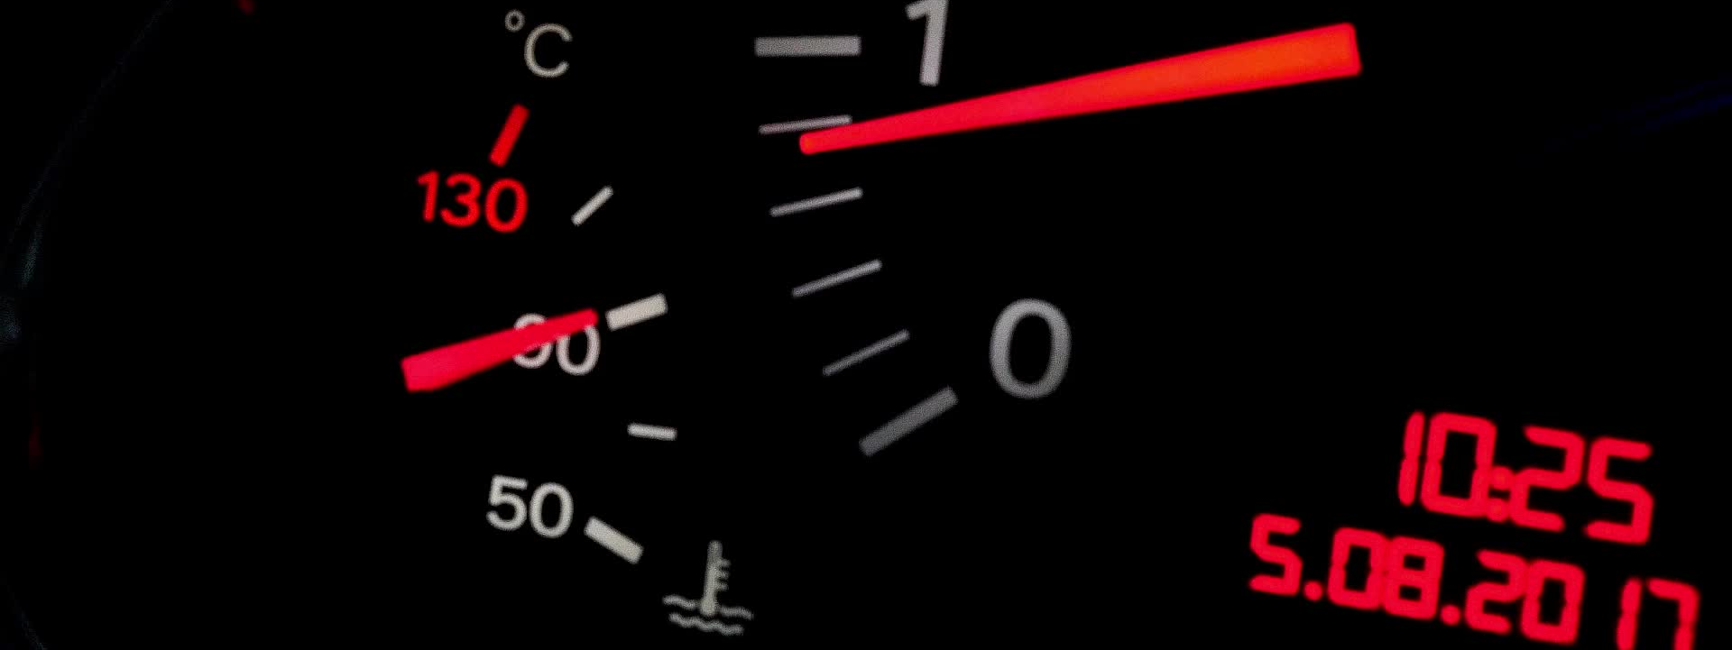
DASHBOARD

Slide 11
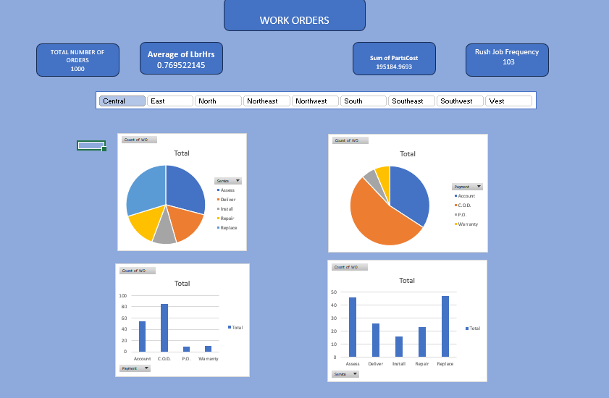

Slide 12
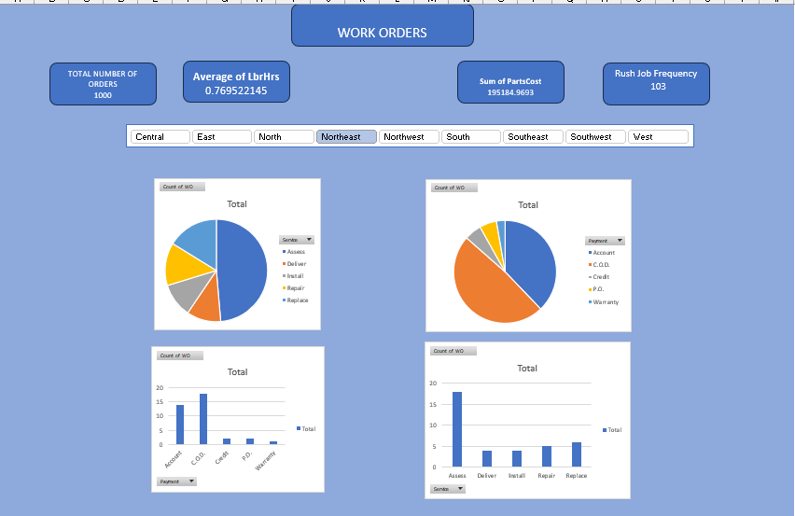

Slide 13
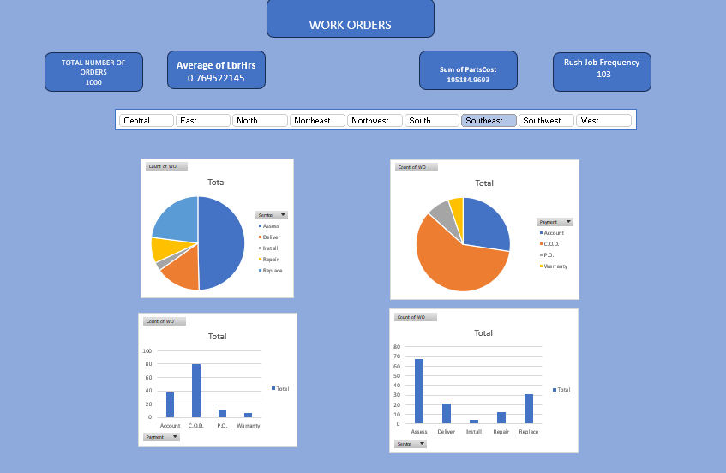

Slide 14
Dashboard
The Dashboard is designed to view the key metrics of the dataset at the first place
The Visualizations are filtered based on district and will be easy to know the distribution of payment type and service

